Slide 1

Madrid Daily Weather Analysis

Slide 2
Madrid Daily Weather Analysis
Project Title: Madrid Daily Weather Analysis
Course: Data Science Toolbox – Python Programming
Name: P. Hemanth
Reg. No.: 12304744
Programme & Section: K23GN30
Course Code: CSE375
Guide: Mrs. Aashima (UID: 28968)
Lovely Professional University
Semester: Jan - April 2025

Slide 3

Introduction
Data analysis helps extract insights from raw data
We analyzed Madrid’s weather from 1997–2015
Used Python for EDA, statistics, visualization, modeling
Focus on temperature patterns and predictions
Tools: pandas, NumPy, matplotlib, seaborn
Applied data cleaning and transformation
Built understanding of seasonal changes
Presented trends using plots
Used regression to predict mean temperatures

Slide 4

What is EDA?
EDA = Exploratory Data Analysis
Summarizes dataset characteristics using visuals/statistics
Detects anomalies, outliers, and data issues
Helps understand patterns before modeling
Visual tools: boxplot, heatmap, scatter, bar chart
Guides decisions on feature engineering
Supports hypothesis formation
Ensures meaningful analysis
Makes data analysis more insightful

Slide 5
Source of Dataset
Format: CSV file
Covers 19 years of daily records
Key columns: Date, Min/Max/Mean Temperature
Includes other weather metrics
Source: https://mavenanalytics.io/data-playground?order=date_added%2Cdesc&page=2&pageSize=5&search=ma
Data range: Jan 1, 1997 – Dec 31, 2015
Used for long-term climate pattern analysis
Loaded using pandas

Slide 6

Data Cleaning & Preprocessing
Loaded dataset with pandas.read_csv()
Removed whitespace from column names
Converted ‘CET’ to datetime format
Dropped rows with invalid dates
Filled numeric nulls with column mean
Extracted Month, Year, Day from dates
Ensured consistent data types
Dataset ready for analysis
Preprocessing improves quality

Slide 7
Summary Statistics
Used df.describe() for data overview
df.info() checked datatypes and nulls
Checked temperature column distributions
Correlation matrices showed relationships
Identified consistency in readings
Summary gave min, max, mean, std deviation
Ensured data readiness for visualization
No severe missing data post cleaning
Reliable dataset confirmed

Slide 8
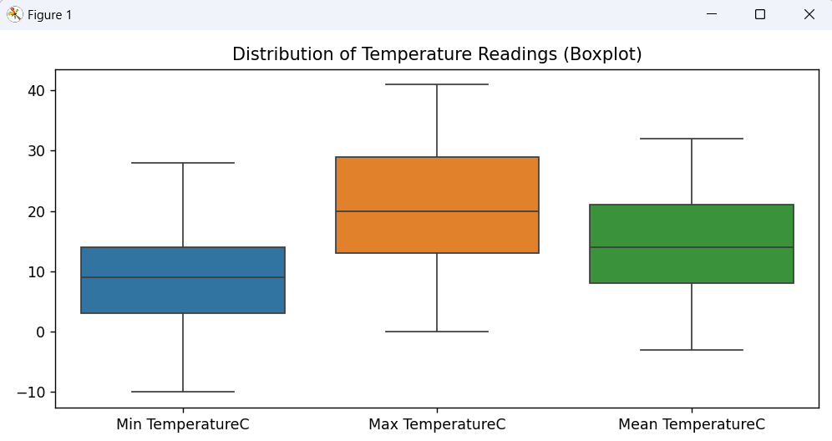
Temperature Distribution
Focus on Min, Max, Mean Temperature
Used seaborn boxplots for visualization
Showed median, quartiles, and outliers
Observed seasonal behavior
Allowed climate behavior interpretation
Some temperature outliers found
Important for understanding range

Slide 9
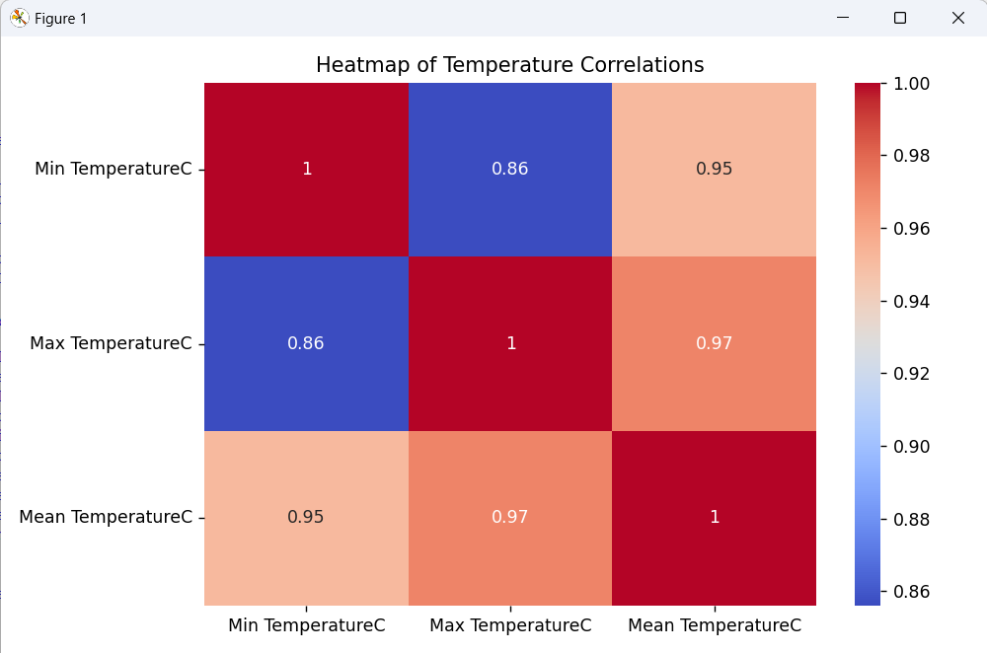
Correlation Between Temperatures
Checked correlation among temperature types
Used pandas .corr() for matrix
Plotted heatmap using seaborn
Found strong positive correlation
Especially between Min and Mean Temp
Proves consistent measurement
Heatmap showed strong links
Helps in prediction
Insightful for modeling

Slide 10
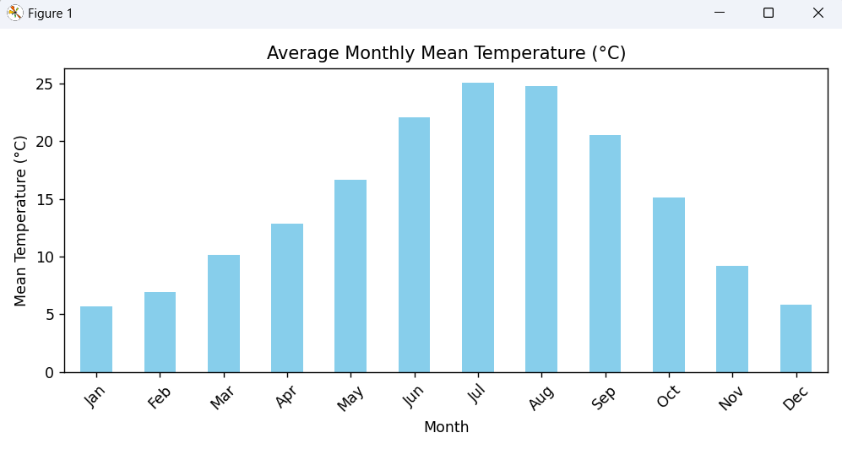
Monthly Average Analysis
Monthly temperature averages calculated
Used groupby() and bar chart
Clear seasonal cycle observed
Rise from Jan to July, then decline
Matches Mediterranean weather
High in summer, low in winter
Supports planning decisions
Useful in forecasting
Bar chart used

Slide 11
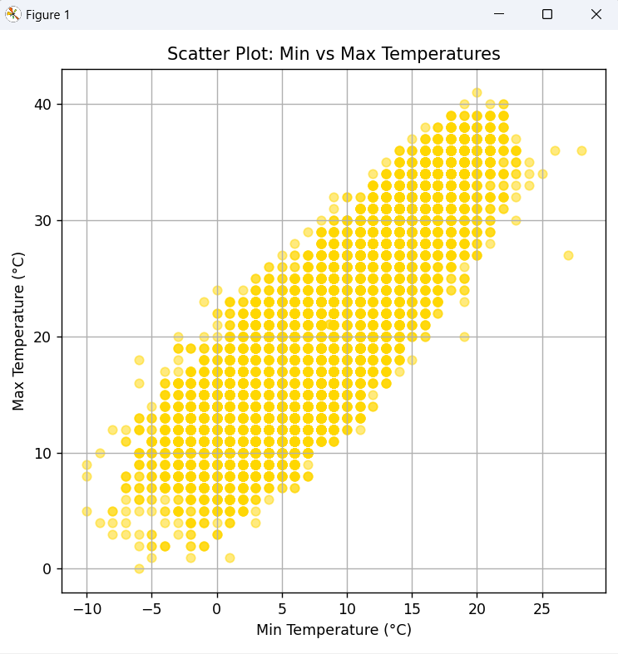
Scatter Plot – Min vs Max
Scatter of Min vs Max Temp
Strong linear relationship
Parallel trendlines seen
Constant temp difference
Helps detect anomalies
Outliers may signal events
Used matplotlib.scatter()
Paired data effectively
Predictive modeling support

Slide 12
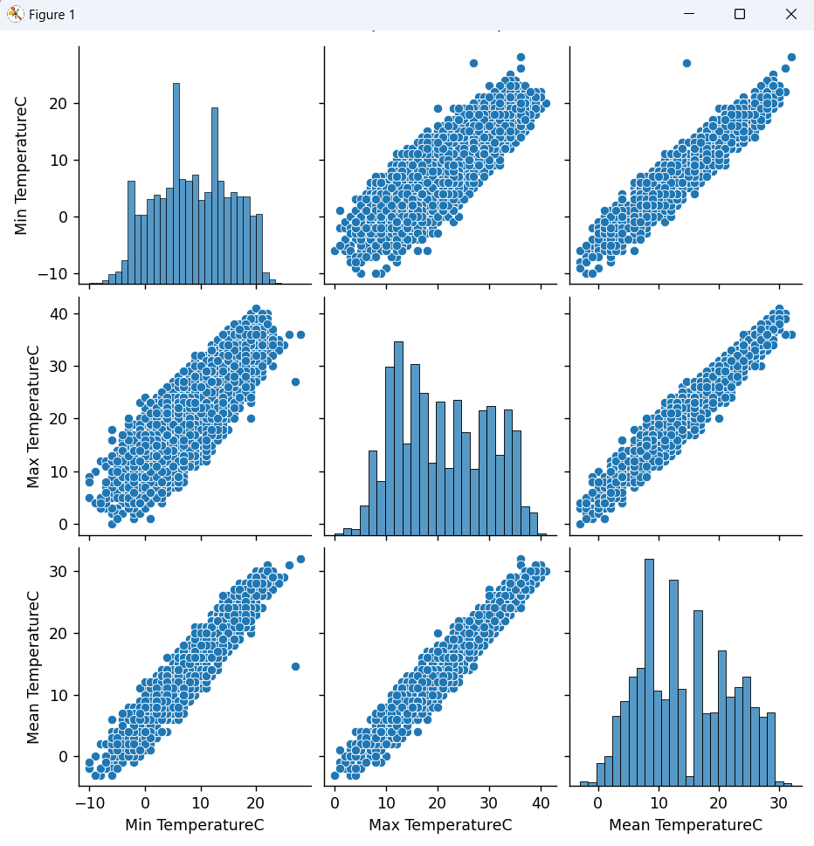
Pairwise Temperature Comparison
Used seaborn.pairplot() for temperature columns
Compared Min, Max, and Mean temperatures
Checked for linearity and clusters
Plots showed strong alignment
Confirmed previous correlation findings
No major outliers detected
Validated consistency in data
Visual stats supported numerical ones
Very informative method

Slide 13
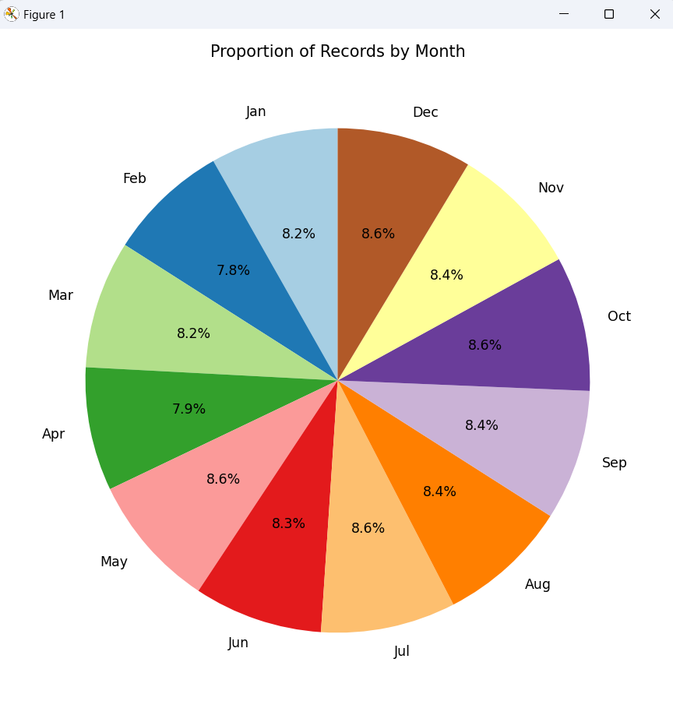
Monthly Record Distribution
Pie chart of data entry distribution by month
Counted entries using value_counts()
Almost equal entries for all months
Ensures uniform data quality
Validates temporal completeness
Used matplotlib pie chart
Month labels Jan to Dec
Reliable representation confirmed
Supports seasonal analysis

Slide 14
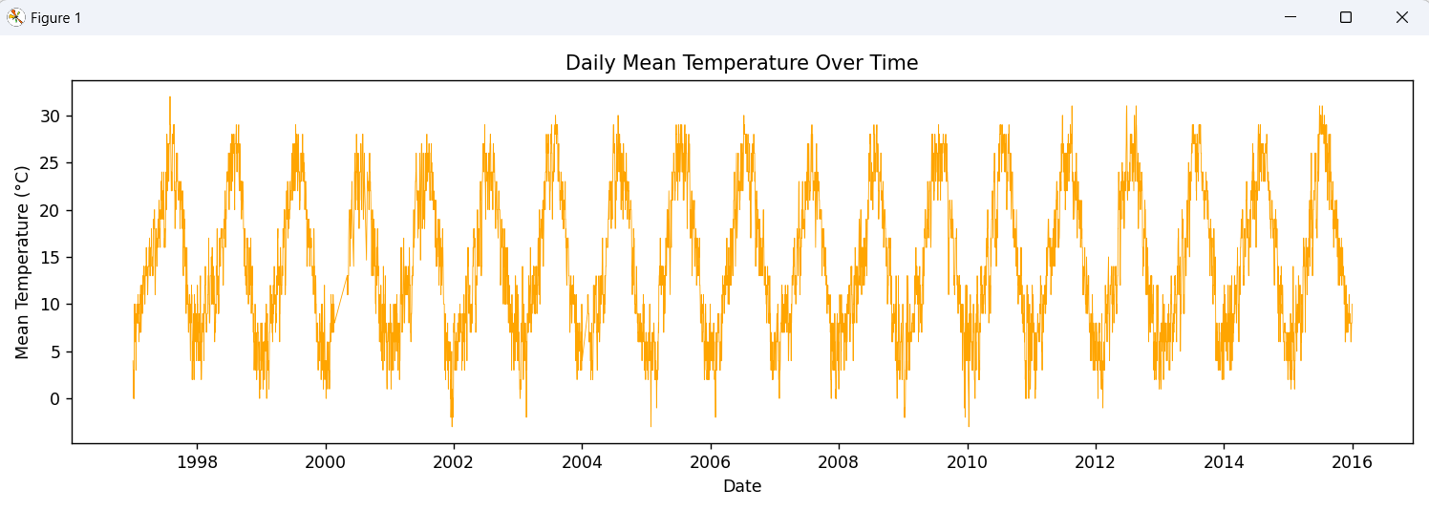
Time Series Analysis
Plotted Mean Temp over time
Seasonal cycles observed yearly
Rise and fall in each year
Minor year-to-year differences
Analyzed long-term climate change
Line plot used for trend clarity
Seasonal patterns confirmed
Insights into climate consistency
Good base for anomaly detection

Slide 15
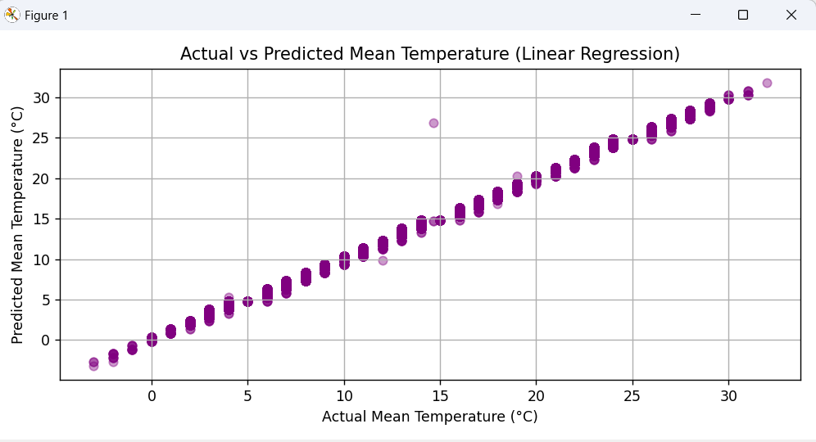
Predictive Modeling – Linear Regression
Predicted Mean Temp from Min and Max
Manual regression (no sklearn used)
Applied normal equation for model
Calculated Mean Squared Error (MSE)
Low MSE = good prediction accuracy
Prediction matched actual values closely
2 input features used in model
Plotted actual vs predicted results
Simple and effective model built

Slide 16

Conclusion
Completed full weather data analysis
Used Python libraries for EDA and modeling
Identified seasonal temperature patterns
High correlation among temperature measures
Created accurate predictive model
Demonstrated real-world data science use
Cleaned, visualized, and interpreted data
Strong outcomes from basic tools
Project objectives successfully met

Slide 17

Future Scope
Use ML models like SVR, Random Forest
Add humidity, wind, rainfall features
Create web dashboard for live updates
Detect anomalies and climate changes
Analyze larger or global datasets
Connect with real-time weather APIs
Enhance automation of analysis
Use AI for deeper insights
Support decision-making tools

Slide 18

References
Pandas Documentation
Matplotlib Official Docs
Seaborn Library Guide
NumPy Documentation
Python Official Docs
RealPython Tutorials
Stack Overflow (code support)
LPU INT375 Course Material

Slide 19
Thank you

